Slide 1
Radio Buttons vs. Checkboxes
Notes:
[Mandatory Slide]
The Radio Buttons and Checkboxes are two TYPES of input associated with the Form’s INPUT element.
Their behaviors can be very tricky with value bindings using the v-model directive.

Slide 2
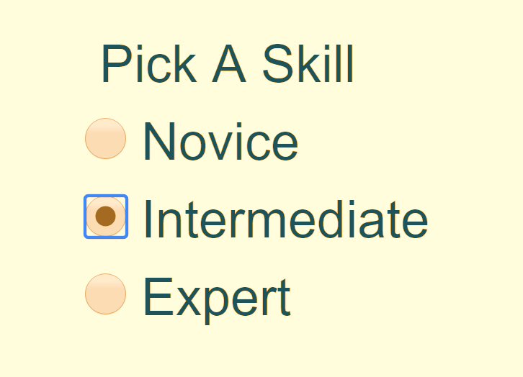
Radio Buttons
Generally used in a group of related options
Only one radio button can be selected at the same time in a given group
The true-value and false-value are ignored on Radio buttons.
The value attribute is affected when binding with v-model
Useful for guaranteeing that one value is submitted in a form

Slide 3
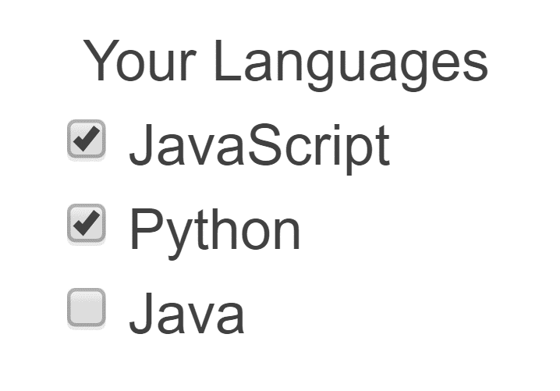
Checkboxes
Generally used independently, not tied to a group
Any number of values or none can be selected at the same time
The true-value and false-value do not affect the value attribute with v-model
Checkbox values are not included in form submissions
No guarantee that at least one value is submitted in a form

Slide 4
Resolving Issues With Routing and State Management
Next Section
Notes:
[Mandatory Slide] This is the end of this section.
In the next section, we’ll take a look at issues concerning Routing and State Management.

